Slide 1

Alberta Bionix

Slide 2
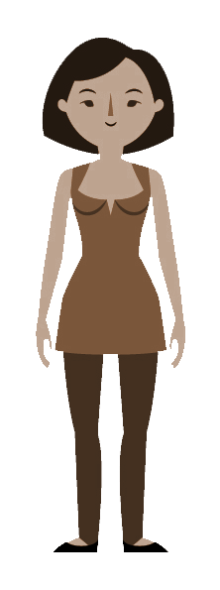
Scenario
Jane
Bio
Jane has spent most of her life being a Veterinarian. A year ago, she had a ischemic stroke causing her to lose some of her vital motor movement functions. Despite the physical limitations she has found happiness in watching soap operas and reading.
Age: 46
Gender: Female
Location: Vancouver, BC
Likes:
-Basketball
-Hiking
-Dogs
Dislikes:
-Broccoli
-Planes

Slide 3
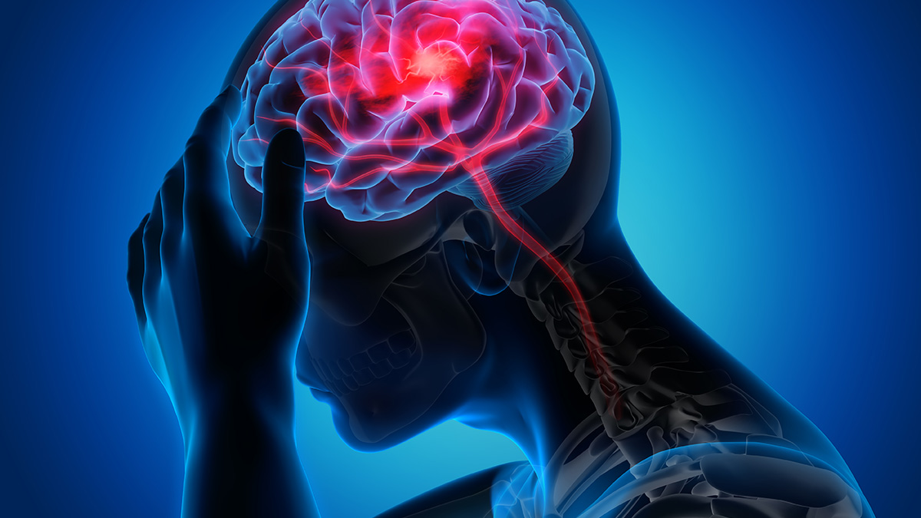
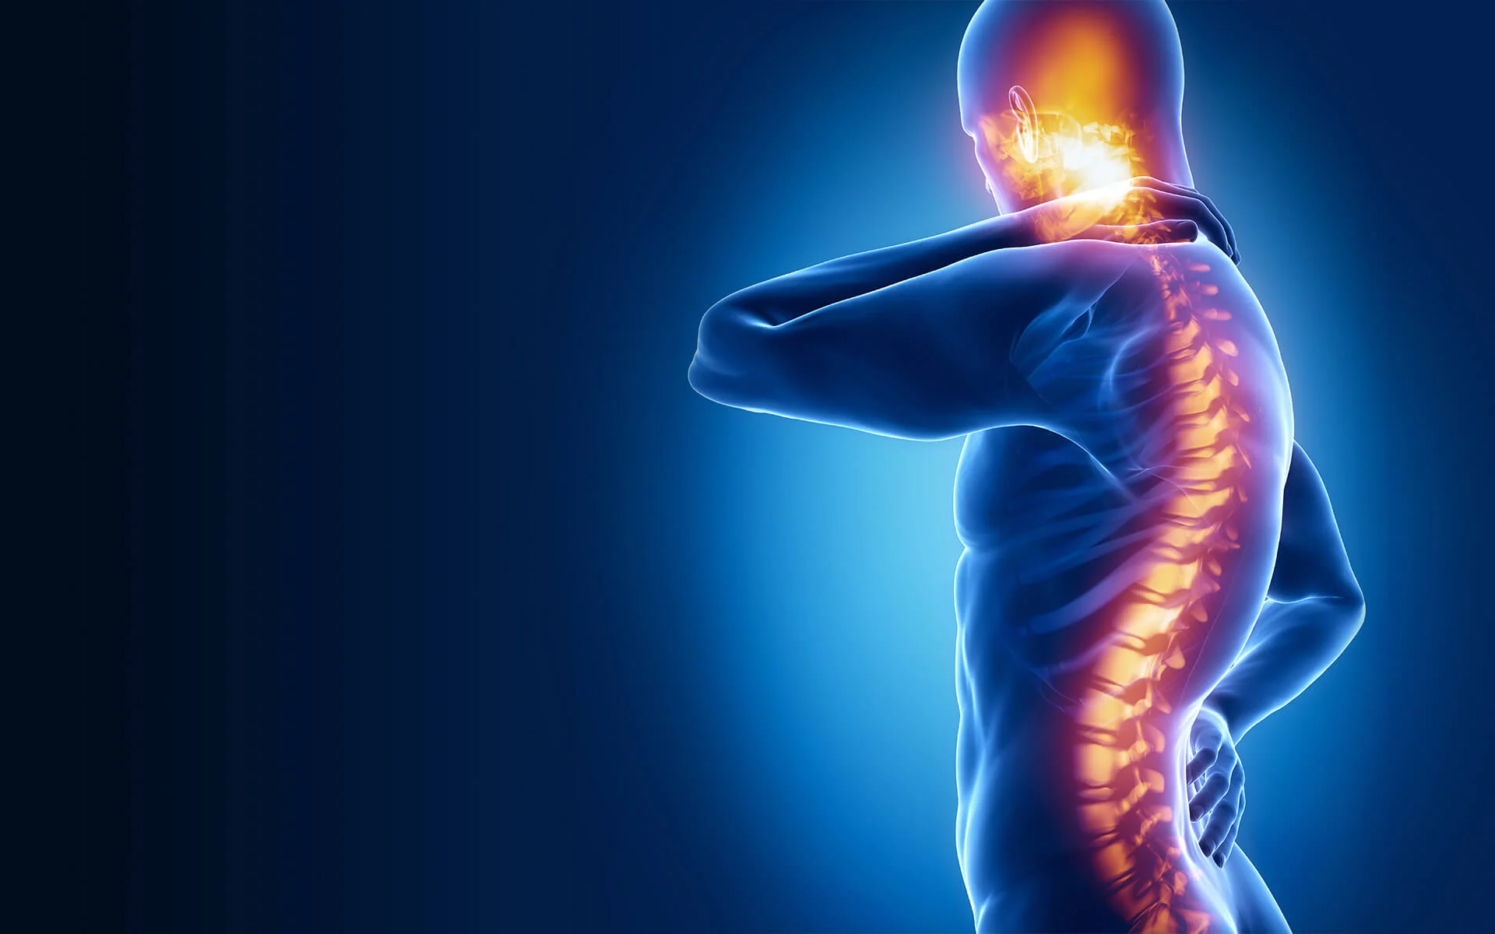
Millions of Others Like Jane
~15 million people yearly are affected by stroke worldwide
(5 million become permanently affected) [1]
Not only strokes:
Traumatic Brain Injury (TBI) → 49 million in 2019 [2]
Spinal Cord Injury (SCI) → 15 million as of 2024 [3]
Amyotrophic lateral sclerosis (ALS) → 1 in 400 lifetime risk [4]
Ataxia → 1 in 50,000 people [5]

Slide 4
What is NeuroMotion?
A tool that captures EEG motor imagery signals and uses them to display the user’s intended movement

Slide 5
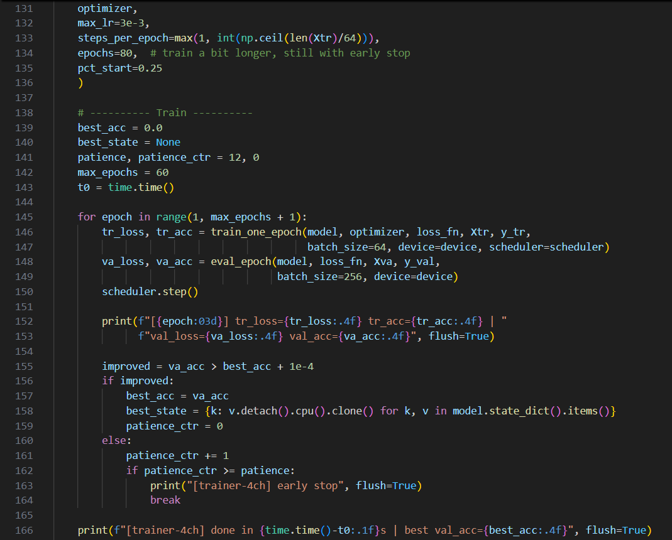
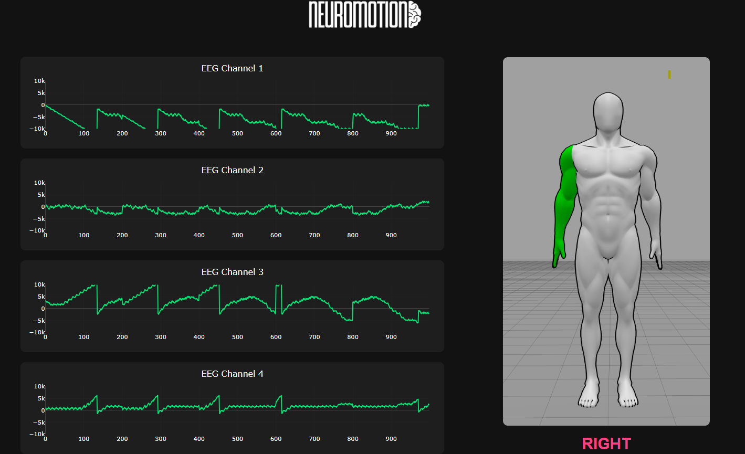
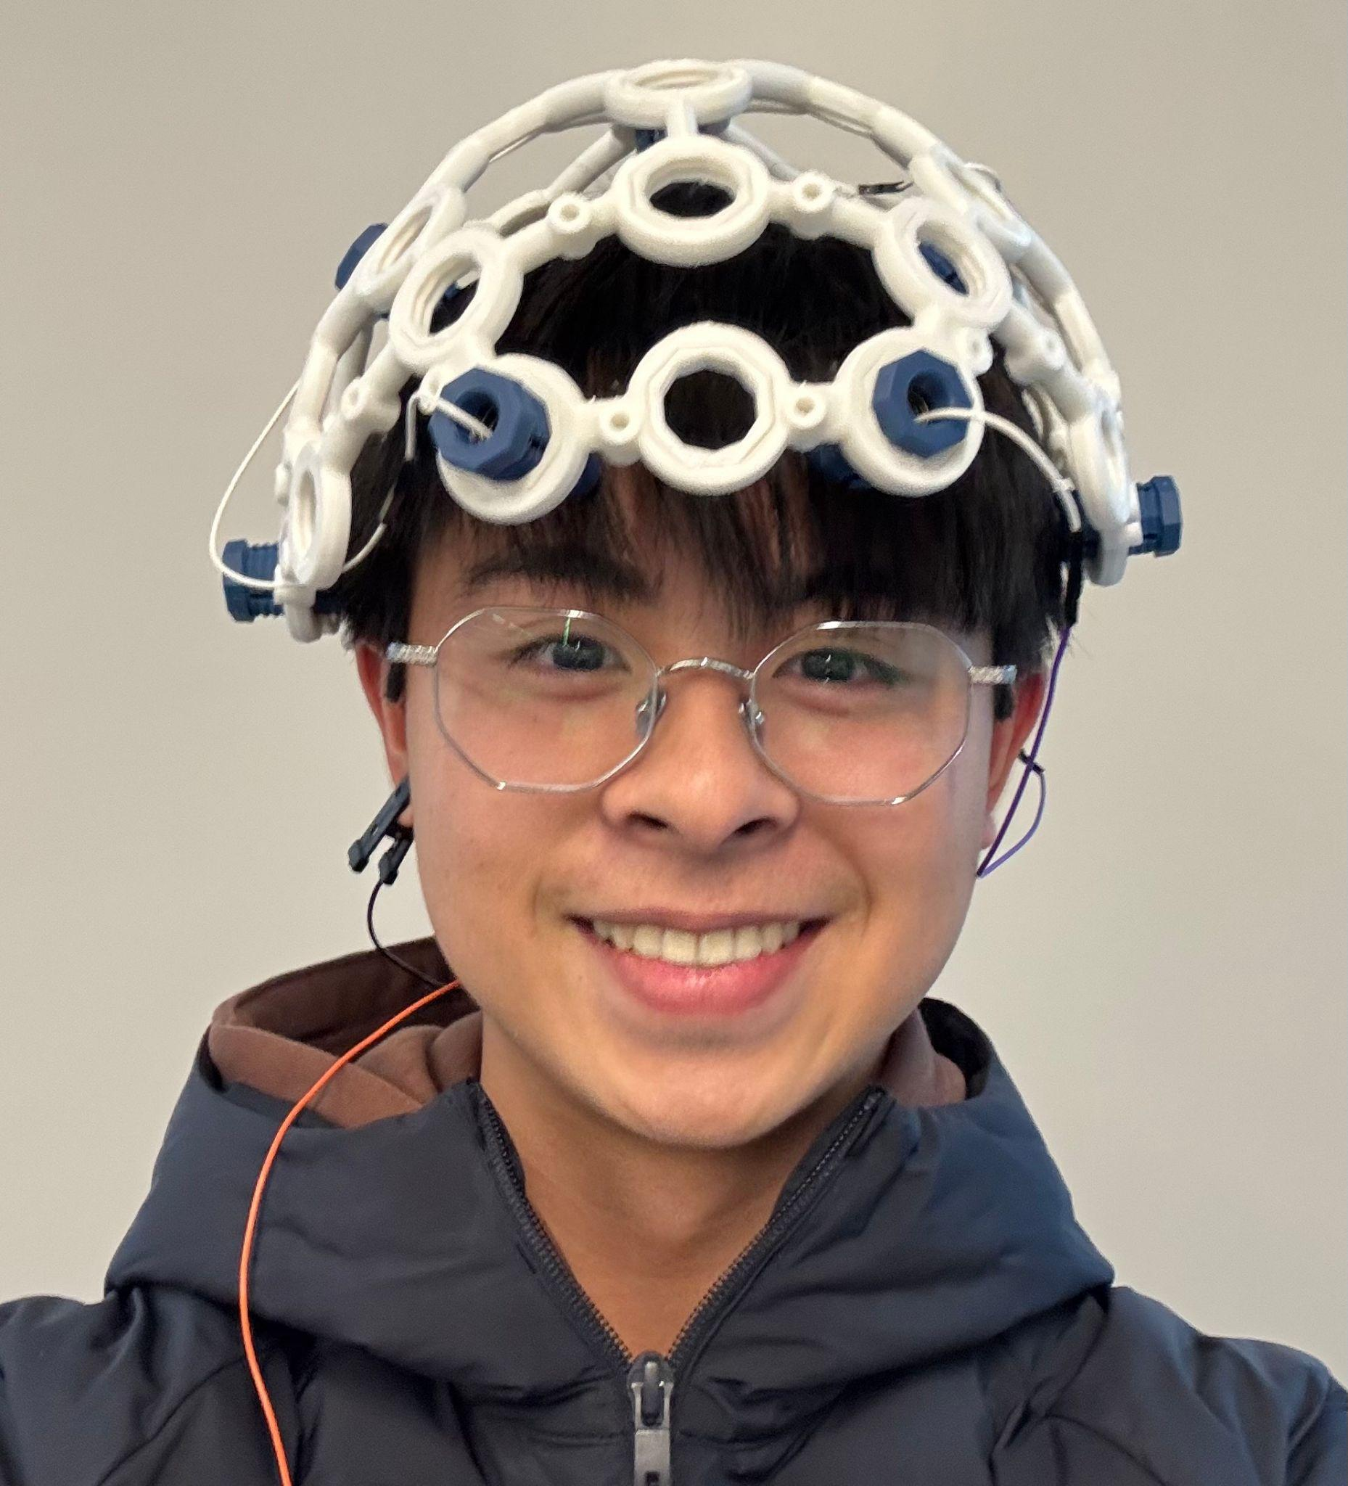
PROCESS
1.Read
2.Predict
3.Display
Capture raw EEG’s using OpenBCI headset
Apply filtering and preprocessing to the EEG data
Feed processed data into machine learning model
Classifies/predicts imagined movement
Display intended movement on Graphical User Interface (GUI) for user feedback

Slide 6

Video Demo

Slide 7
Further Applications
Assistive Technology
Neurorehabilitation and FES
Researchers and Clinicians
The system can help them interact with devices or control assistive technologies through thought-based commands
Those recovering from strokes, spinal cord injuries, or neuromuscular disorders can use EEG motor imagery feedback for rehabilitation and brain retraining.
Gain affordable access to real-time brain signal tracking for studying motor cortex activity and brain–computer interface (BCI) applications.

Slide 8
Sources
[1]H. Yang, J. Wan, Y. Jin, X. Yu, and Y. Fang, “EEG- and EMG-Driven Poststroke Rehabilitation: A Review,” IEEE Sensors Journal, vol. 22, no. 24, pp. 23649–23660, Dec. 2022, doi: https://doi.org/10.1109/JSEN.2022.3220930.
[2]B. Guan, D. Anderson, L. Chen, S. Feng, and H. Zhou, “Global, regional and national burden of traumatic brain injury and spinal cord injury, 1990–2019: a systematic analysis for the Global Burden of Disease Study 2019,” BMJ Open, vol. 13, no. 10, pp. e075049–e075049, Oct. 2023, doi: https://doi.org/10.1136/bmjopen-2023-075049.
[3]World Health Organization, “Spinal Cord Injury,” World Health Organization, Apr. 16, 2024. https://www.who.int/news-room/fact-sheets/detail/spinal-cord-injury
[4]“ALS Therapy Development Institute,” ALS Therapy Development Institute, 2017. https://www.als.net/what-is-als/?gad_source=1&gad_campaignid=20278958829&gbraid=0AAAAAD1Cxd-A7uWSnRnbJNZLPJNe9vlH6&gclid=CjwKCAiAt8bIBhBpEiwAzH1w6Z58zAOSWMOVwO4Nat906EZsdE7URN-0ZwI6ACsszyVmwUmmuVo-mBoCKH4QAvD_BwE (accessed Nov. 10, 2025).
[5] NHS Choices, “Types - Ataxia,” NHS, 2019. https://www.nhs.uk/conditions/ataxia/symptoms/
‌
‌

